Slide 2

Current Work
$O\left(m^{1.5}\right) −edge itarator$
$O\left(m∙d_{max}\right)−edge iterator$
$O\left(n∙d_{max}^{2}\right) −node iterator$
$O\left(m^{1.41}\right) −Noga Alon. Impractical$

Slide 3
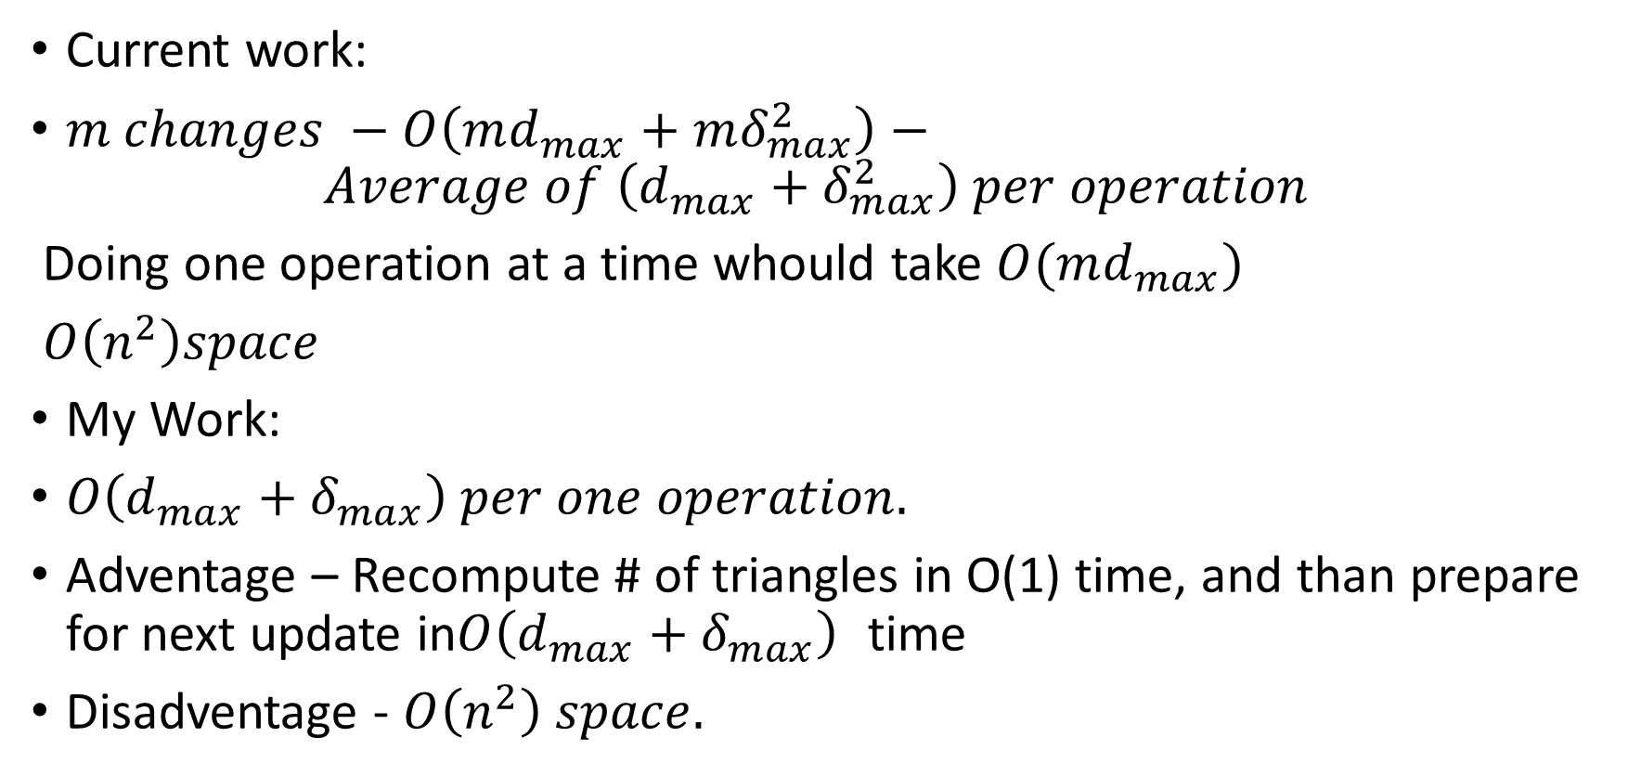
Incremental - Ephemeral
Current work:
$m changes −O\left(md_{max}+mδ_{max}^{2}\right)−$
$$Average of \left(d_{max}+δ_{max}^{2}\right) per operation$$
Doing one operation at a time whould take $O(md_{max})$
$O\left(n^{2}\right)space$
My Work:
$O\left(d_{max}+δ_{max}\right) per one operation.$
Adventage – Recompute # of triangles in O(1) time, and than prepare for next update in$O\left(d_{max}+δ_{max}\right)$ time
Disadventage - $O\left(n^{2}\right) space.$

Slide 4
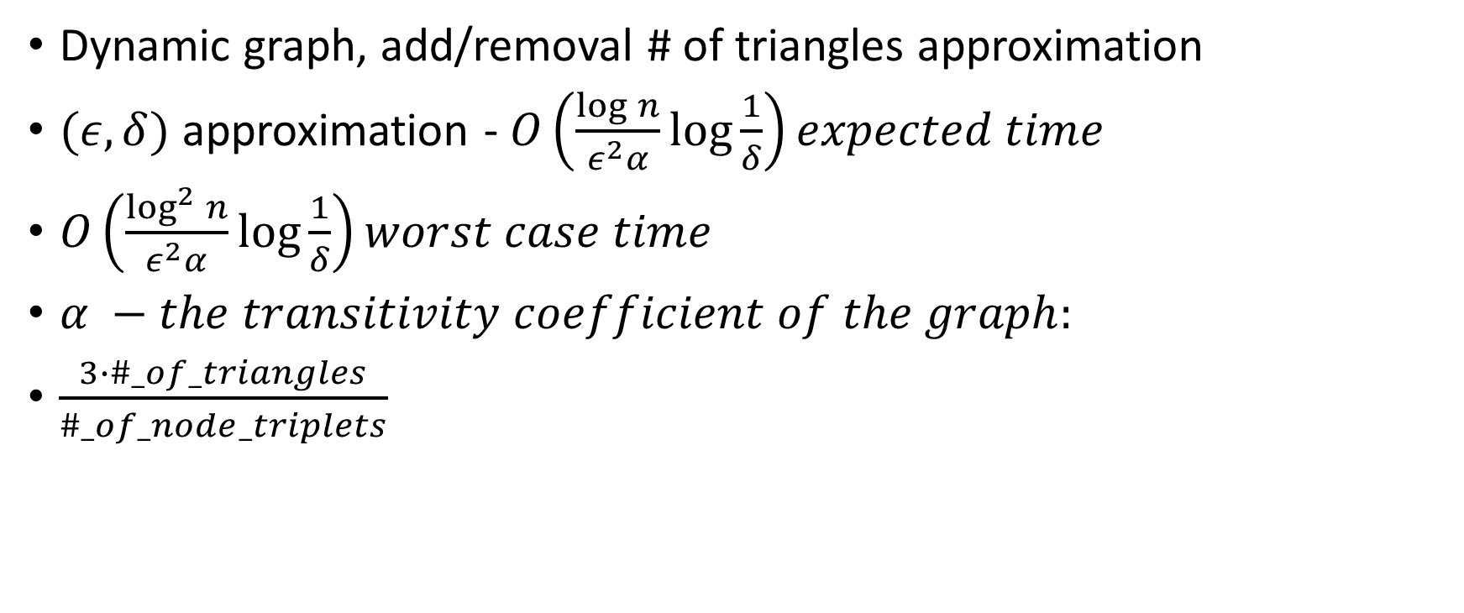
Incremental - approximation
Dynamic graph, add/removal # of triangles approximation
$(ε,δ)$ approximation - $O\left(\frac{\log{n}}{ε^{2}α}\log{\frac{1}{δ}}\right)expected time$
$O\left(\frac{\log^{2}{n}}{ε^{2}α}\log{\frac{1}{δ}}\right)worst case time$
$α −the transitivity coefficient of the graph:$
$\frac{3∙\#_of_triangles}{\#_of_node_triplets}$

Slide 5
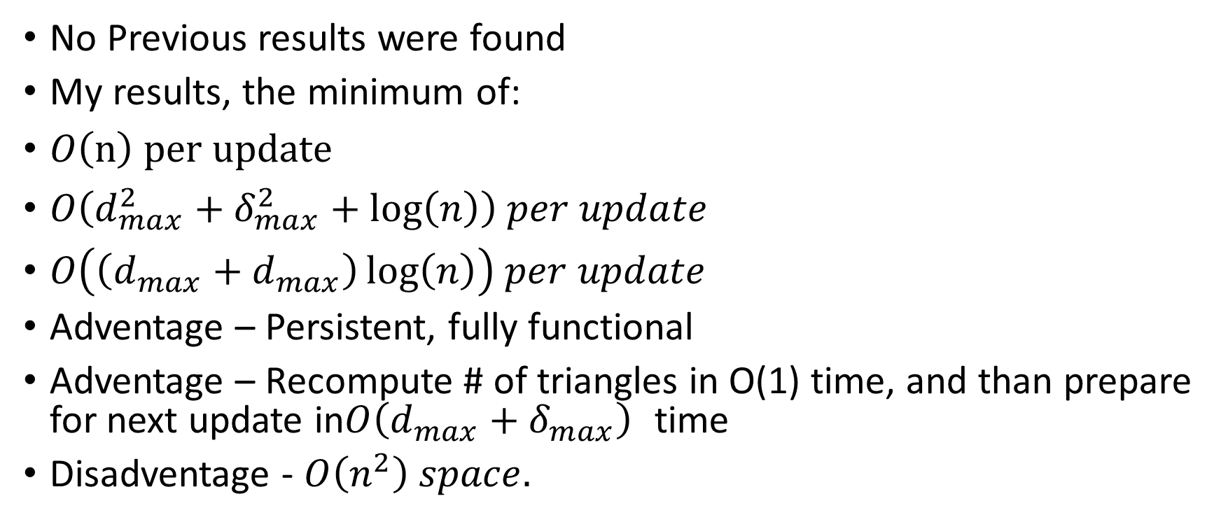
Incremental – Persistent, Fully Functional
No Previous results were found
My results, the minimum of:
$O\left(n\right) per update$
$O\left(d_{max}^{2}+δ_{max}^{2}+\log\left(n\right)\right) per update$
$O\left(\left(d_{max}+d_{max}\right)\log\left(n\right)\right) per update$
Adventage – Persistent, fully functional
Adventage – Recompute # of triangles in O(1) time, and than prepare for next update in$O\left(d_{max}+δ_{max}\right)$ time
Disadventage - $O\left(n^{2}\right) space.$

Slide 6
Performance Results

Slide 7
Persistensy explained

